Slide 1
06/07/23 RTS Update
Jacob Pew Jay Kim Dr. Loveless

Slide 2
Summary
Data collection progress
Parameter extraction progress and results
Data analysis examples collected during test runs
Explanation of how RTS is defined in the python code
Data analysis examples collected post test runs

Slide 3
Samples Summary
Bank 0:
10uA : 3168 Samples
1uA : 2528 Samples
100nA : 3072 Samples
10nA : 3072 Samples
Total : 11840 Samples
Bank 2:
10uA : 3072 Samples
1uA : 4736 Samples
100nA : 3072 Samples
10nA : 0 Samples
Total : 10880 Samples
Bank 1:
10uA : 4805 Samples
1uA : 416 Samples
100nA : 544 Samples
10nA : 3312 Samples
Total : 9045 Samples
3072 = 96 rows * 32 columns = whole bank

Slide 4
Definitions
µ(V_{RTS}) – average amplitude of the RTS seen
RTS – average time spent at RTS amplitude
τ₁₂(ms) – capture/emission time constant
τ₂₁(ms) – capture/emission time constant
τ₁₂/τ₂₁ - Ratio of time constants
µ(N)[Transitions/sample] - Average number of transitions per sample
# of RTS Levels – The highest number of RTS levels seen
# of RTS – Number of signals that were analyzed with RTS for the bank
% RTS - percentage of how many devices showed RTS per bank

Slide 5
Parameter Extraction Progress
Bank | Column | Rows | Devices | Samples | I_{ds} | W/L | I_{DS} | µ(V_{RTS}) | RTS | τ₁₂(ms) | τ₂₁(ms) | τ₁₂/τ₂₁ | µ(N)[Transitions/sample] | # of RTS Levels
0 | 0-31 | 96 | 3072 | 448 | 10uA | 0.28/0.1, 0.28/8, 1.5/0.1, 1.5/0.35, 1.5/1.6, 1.5/8, 8/0.1, 8/8 | 10uA | 535 | 7.6 | 36.9 | 691 | 0.149 | 56.3 | 3
0 | 0-31 | 96 | 3072 | 2528 | 1uA | 0.28/0.1, 0.28/8, 1.5/0.1, 1.5/0.35, 1.5/1.6, 1.5/8, 8/0.1, 8/8 | 1uA | 772 | 1.3 | 34.5 | 848 | 0.122 | 52.7 | 4
0 | 0-31 | 96 | 3072 | 3072 | 100nA | 0.28/0.1, 0.28/8, 1.5/0.1, 1.5/0.35, 1.5/1.6, 1.5/8, 8/0.1, 8/8 | 100nA | 3010 | 0.026 | 20.4 | 613 | 0.0864 | 45.4 | 4
0 | 0-31 | 96 | 3072 | 3072 | 10nA | 0.28/0.1, 0.28/8, 1.5/0.1, 1.5/0.35, 1.5/1.6, 1.5/8, 8/0.1, 8/8 | 10nA | 1050 | 2.4 | 19 | 447 | 0.132 | 174 | 4
1 | 32-63 | 96 | 3072 | 3072 | 10uA | 0.28/0.1, 0.28/8, 1.5/0.1, 1.5/0.35, 1.5/1.6, 1.5/8, 8/0.1, 8/8 | 10uA | 667 | 3.8 | 57.9 | 946 | 0.12 | 43.7 | 4
1 | 32-63 | 96 | 3072 | 416 | 1uA | 0.28/0.1, 0.28/8, 1.5/0.1, 1.5/0.35, 1.5/1.6, 1.5/8, 8/0.1, 8/8 | 1uA | 1300 | 5 | 52.9 | 341 | 0.237 | 44.3 | 3
1 | 32-63 | 96 | 3072 | 544 | 100nA | 0.28/0.1, 0.28/8, 1.5/0.1, 1.5/0.35, 1.5/1.6, 1.5/8, 8/0.1, 8/8 | 100nA | 1360 | 0.86 | 117 | 2260 | 0.0705 | 33.6 | 3
1 | 32-63 | 96 | 3072 | 784 | 10nA | 0.28/0.1, 0.28/8, 1.5/0.1, 1.5/0.35, 1.5/1.6, 1.5/8, 8/0.1, 8/8 | 10nA | 1930 | 3 | 34.7 | 178 | 0.223 | 72.3 | 4
2 | 64-95 | 96 | 3072 | 3072 | 10uA | 0.42/0.35, 0.42/8, 1.2/0.35, 1.2/0.5, 1.2/0.8, 1.2/8, 8/0.35, 8/8 | 10uA | 1270 | 34 | 95.1 | 735 | 0.396 | 47.1 | 3
2 | 64-95 | 96 | 3072 | 3072 | 1uA | 0.42/0.35, 0.42/8, 1.2/0.35, 1.2/0.5, 1.2/0.8, 1.2/8, 8/0.35, 8/8 | 1uA | 1430 | 33 | 57.6 | 957 | 0.132 | 43.5 | 4
2 | 64-95 | 96 | 3072 | 0 | 100nA | 0.42/0.35, 0.42/8, 1.2/0.35, 1.2/0.5, 1.2/0.8, 1.2/8, 8/0.35, 8/8 | 100nA
2 | 64-95 | 96 | 3072 | 0 | 10nA | 0.42/0.35, 0.42/8, 1.2/0.35, 1.2/0.5, 1.2/0.8, 1.2/8, 8/0.35, 8/8 | 10nA
3 | 96-127 | 96 | 3072 | 0 | 10uA | 0.42/0.35, 0.42/8, 1.2/0.35, 1.2/0.5, 1.2/0.8, 1.2/8, 8/0.35, 8/8 | 10uA
3 | 96-127 | 96 | 3072 | 0 | 1uA | 0.42/0.35, 0.42/8, 1.2/0.35, 1.2/0.5, 1.2/0.8, 1.2/8, 8/0.35, 8/8 | 1uA
3 | 96-127 | 96 | 3072 | 0 | 100nA | 0.42/0.35, 0.42/8, 1.2/0.35, 1.2/0.5, 1.2/0.8, 1.2/8, 8/0.35, 8/8 | 100nA
3 | 96-127 | 96 | 3072 | 0 | 10nA | 0.42/0.35, 0.42/8, 1.2/0.35, 1.2/0.5, 1.2/0.8, 1.2/8, 8/0.35, 8/8 | 10nA

Slide 6
Statistical RTS Summary
Bank | Bias Condition | FET Type | # of RTS | Samples | % RTS
0 | 10uA | BLOCK_NMOSLV | 35 | 448 | 7.8%
0 | 1uA | BLOCK_NMOSLV | 159 | 2528 | 6.3%
0 | 100nA | BLOCK_NMOSLV | 47 | 3072 | 1.5%
0 | 10nA | BLOCK_NMOSLV | 166 | 3072 | 5.4%
1 | 10uA | BLOCK_NMOSLV_DNWELL | 240 | 3072 | 7.8%
1 | 1uA | BLOCK_NMOSLV_DNWELL | 17 | 416 | 4.1%
1 | 100nA | BLOCK_NMOSLV_DNWELL | 28 | 544 | 5.1%
1 | 10nA | BLOCK_NMOSLV_DNWELL | 16 | 784 | 2.0%
2 | 10uA | BLOCK_NMOSHV | 213 | 3072 | 6.9%
2 | 1uA | BLOCK_NMOSHV | 635 | 3072 | 20.7%
2 | 100nA | BLOCK_NMOSHV
2 | 10nA | BLOCK_NMOSHV
3 | 10uA | BLOCK_NMOSHV_DNWELL
3 | 1uA | BLOCK_NMOSHV_DNWELL
3 | 100nA | BLOCK_NMOSHV_DNWELL
3 | 10nA | BLOCK_NMOSHV_DNWELL

Slide 7
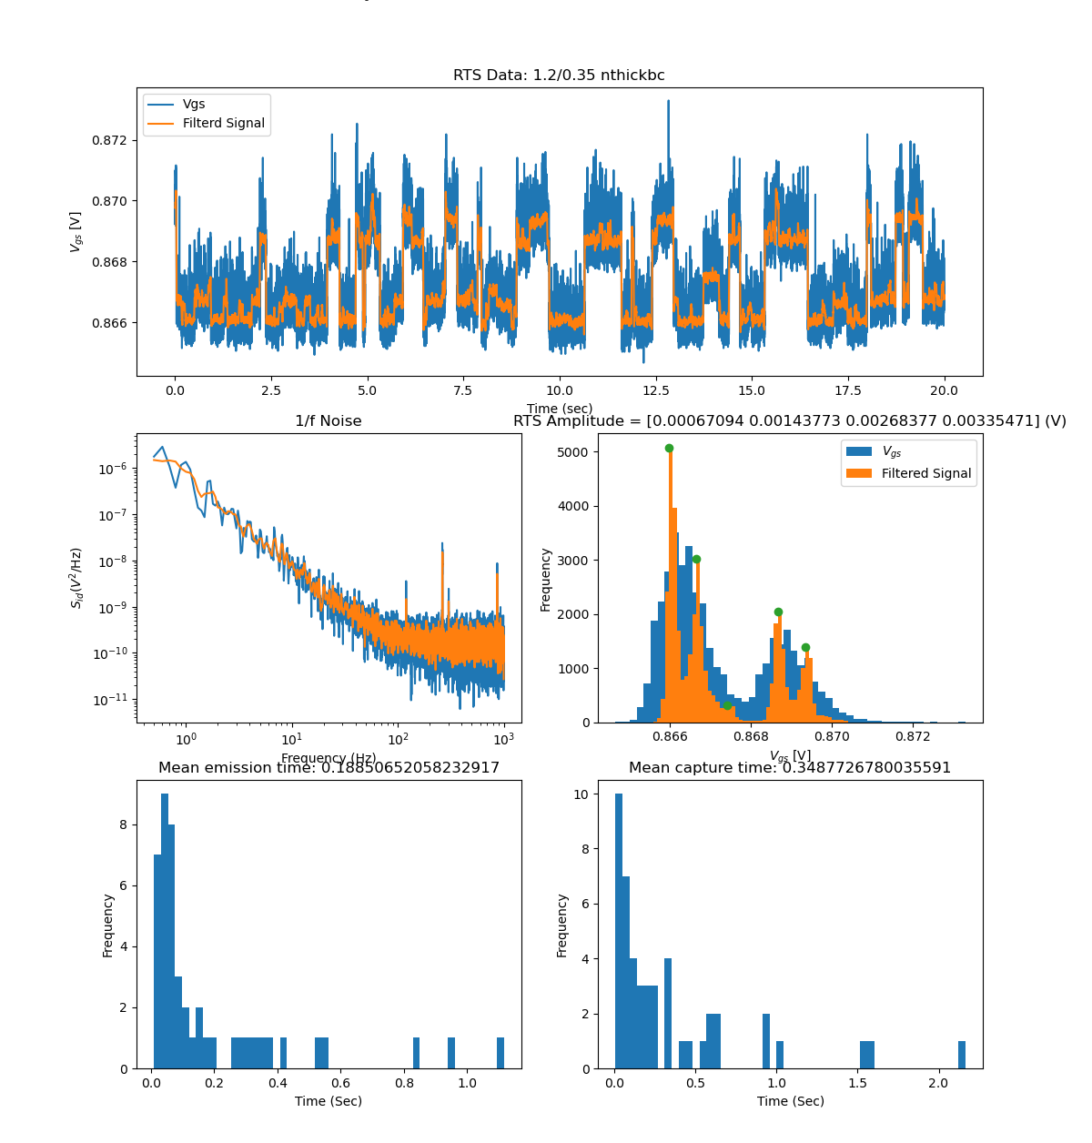
Bank 2
Vg = 3.3V Vdd = 3.3V Sample Rate = 2 kHz
Ids = 100 nA
Signal is filtered using the savgol filter from scipy package.
Signal is flagged with RTS because the histogram of the filtered signal has more than 1 peak.
1/f noise is calculated using Welch's method from scipy.signal.welch.
Time constants are calculated by finding the peaks of the signal but needs work because it detects too many peaks.

Slide 8
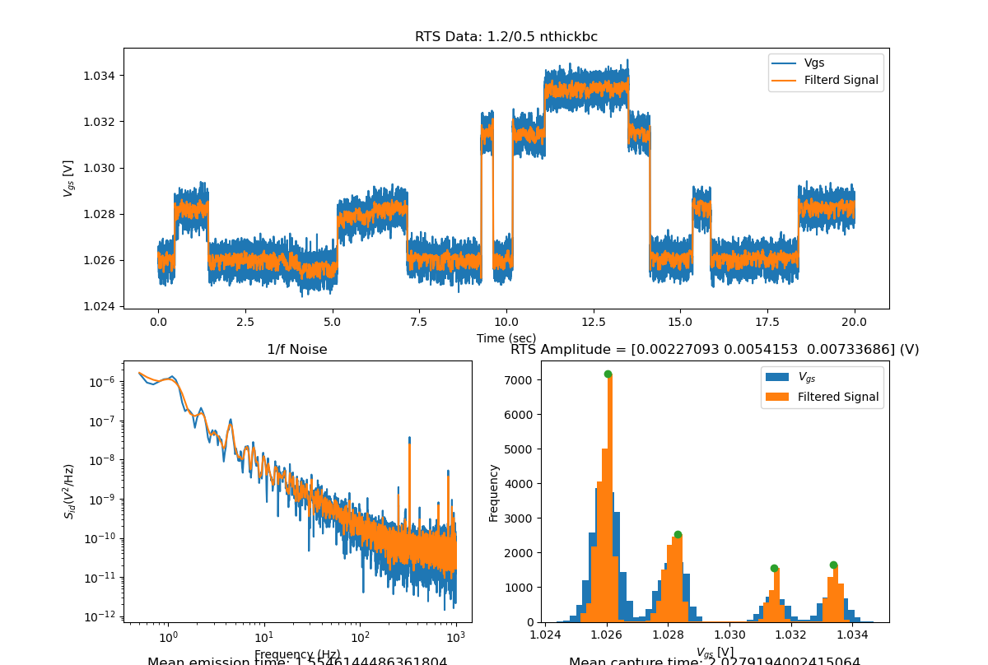
Bank 2
Vg = 3.3V Vdd = 3.3V Sample Rate = 2 kHz
Ids = 100 nA
Steady state is assumed to be the portion of the signal that relates to the highest peak of the histogram.

Slide 9
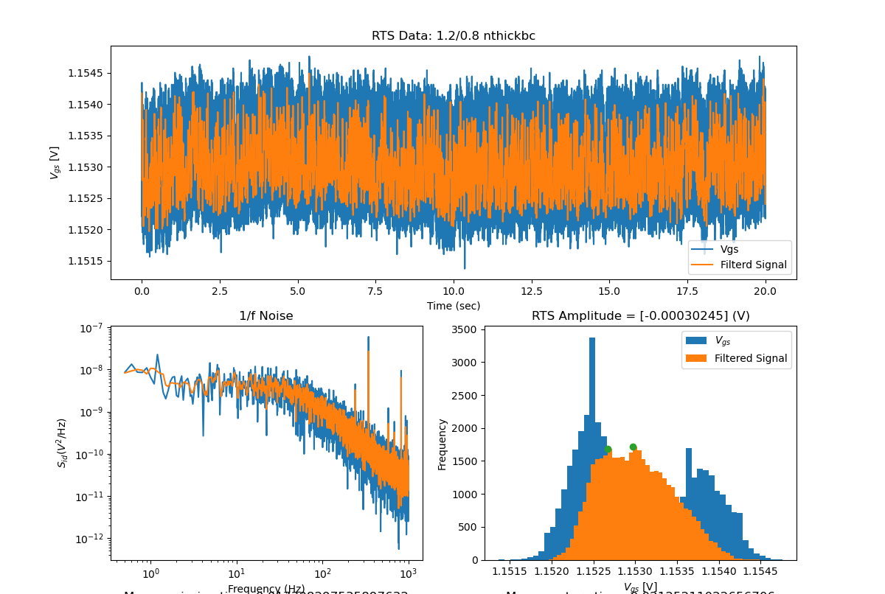
Bank 2
Vg = 3.3V Vdd = 3.3V Sample Rate = 2 kHz
Ids = 100 nA
A signal flagged for RTS that may not be RTS.

Slide 10
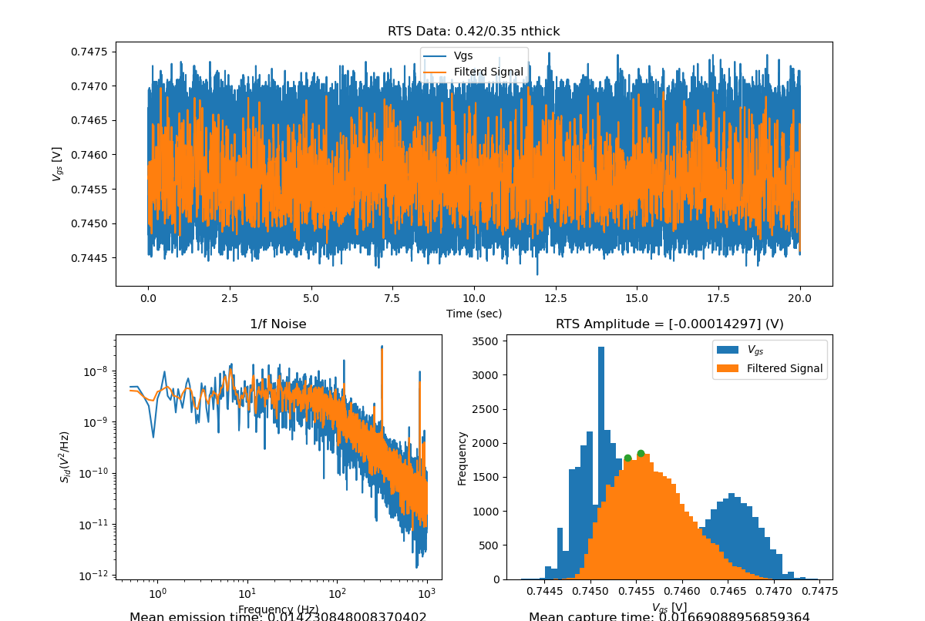
Bank 2
Vg = 3.3V Vdd = 3.3V Sample Rate = 2 kHz
Ids = 100 nA

Slide 11
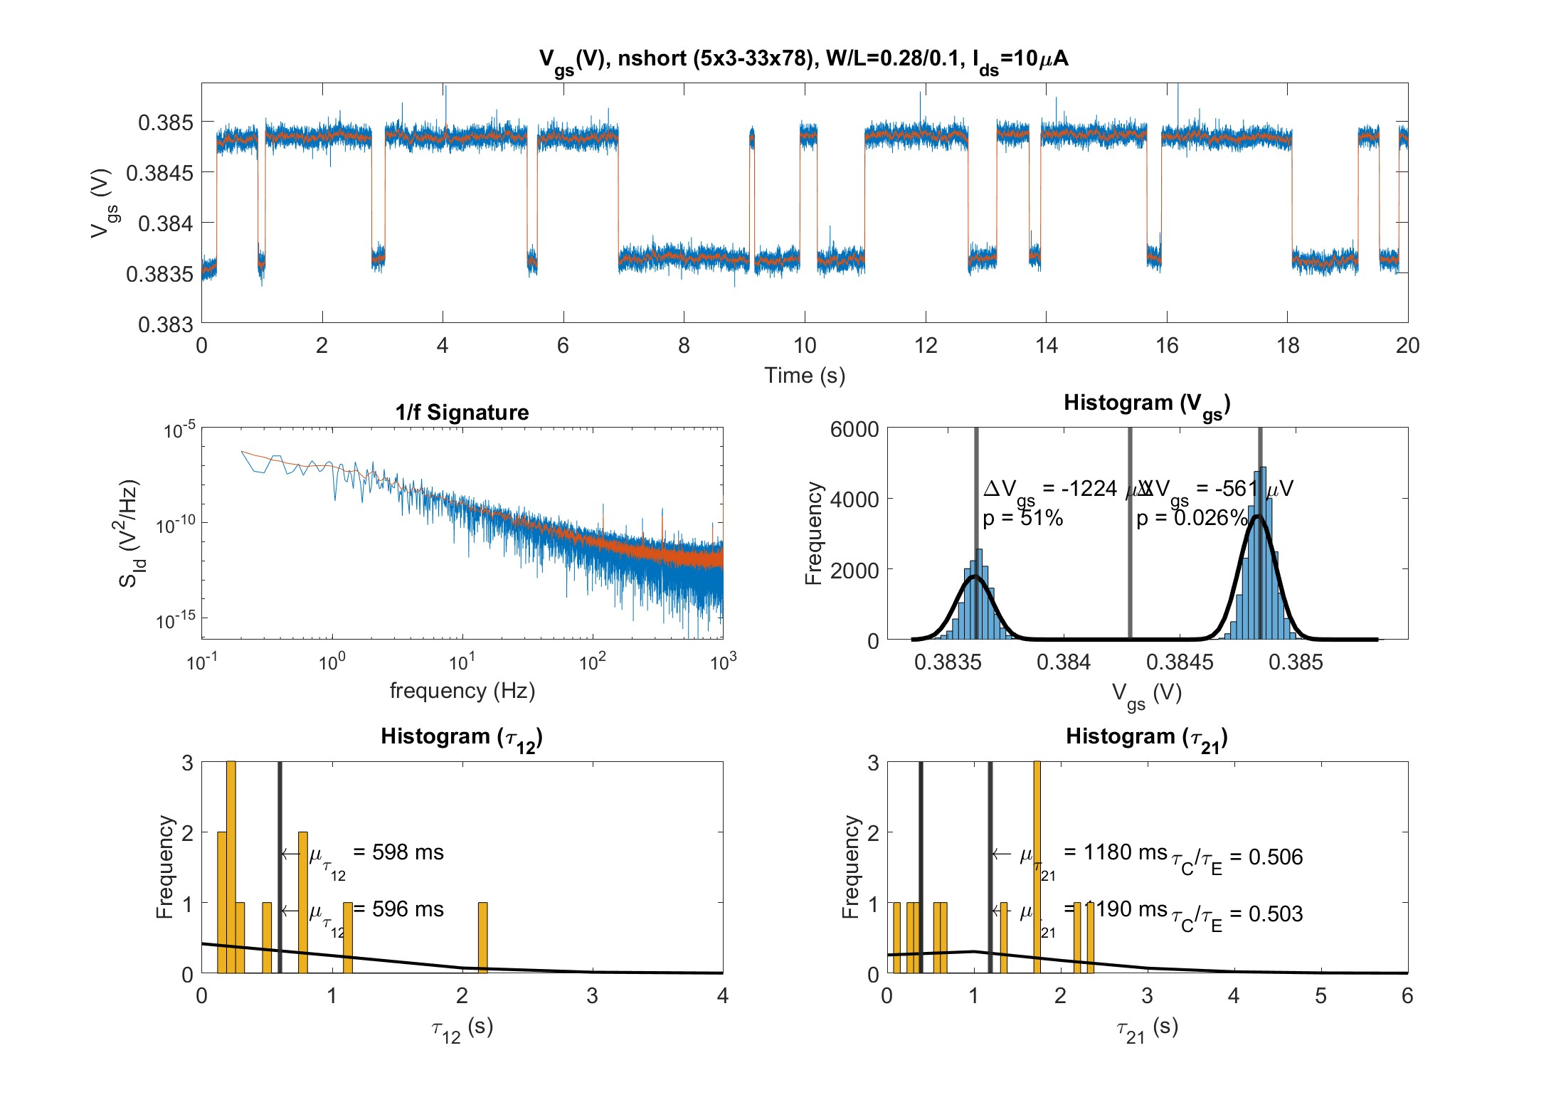
Bank 1 I_{bias} = 10uA Extracted Data

Slide 12
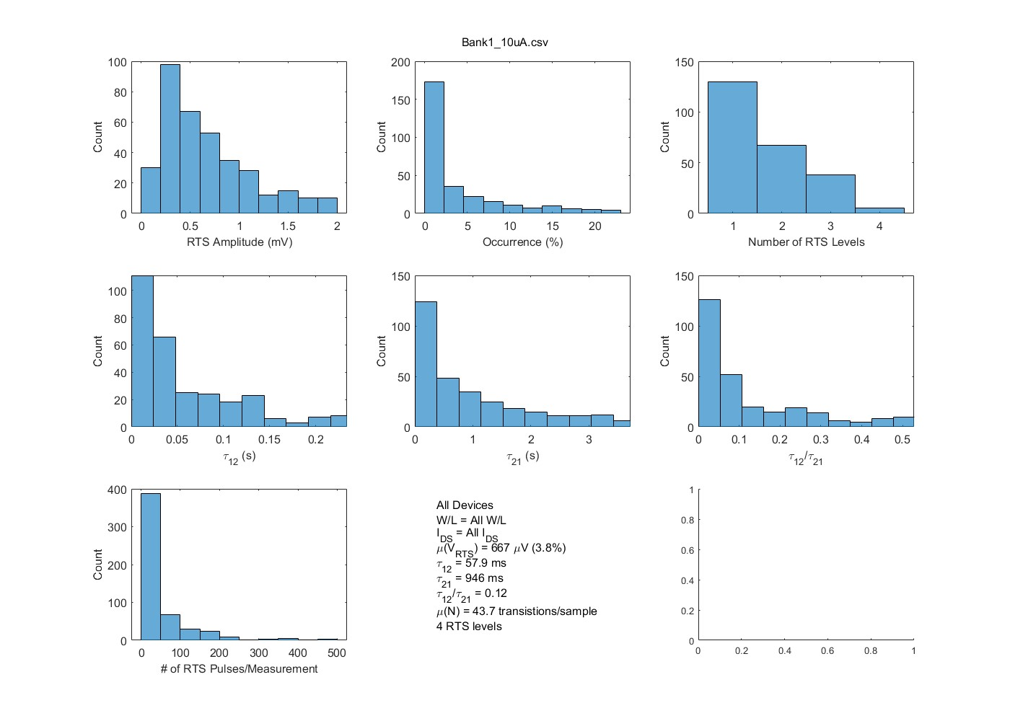
Bank 1 I_{bias} = 10uA Aggregate Data

Slide 13
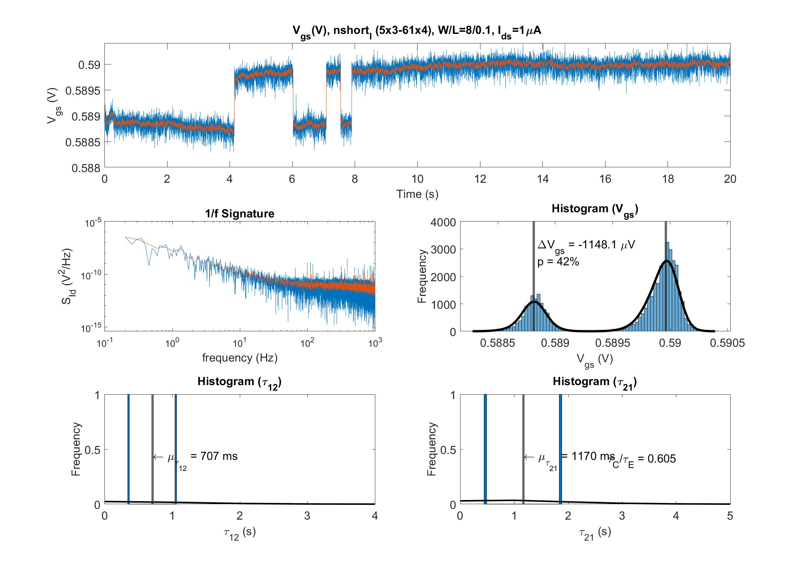
Bank 1 I_{bias} = 1uA Extracted Data

Slide 14
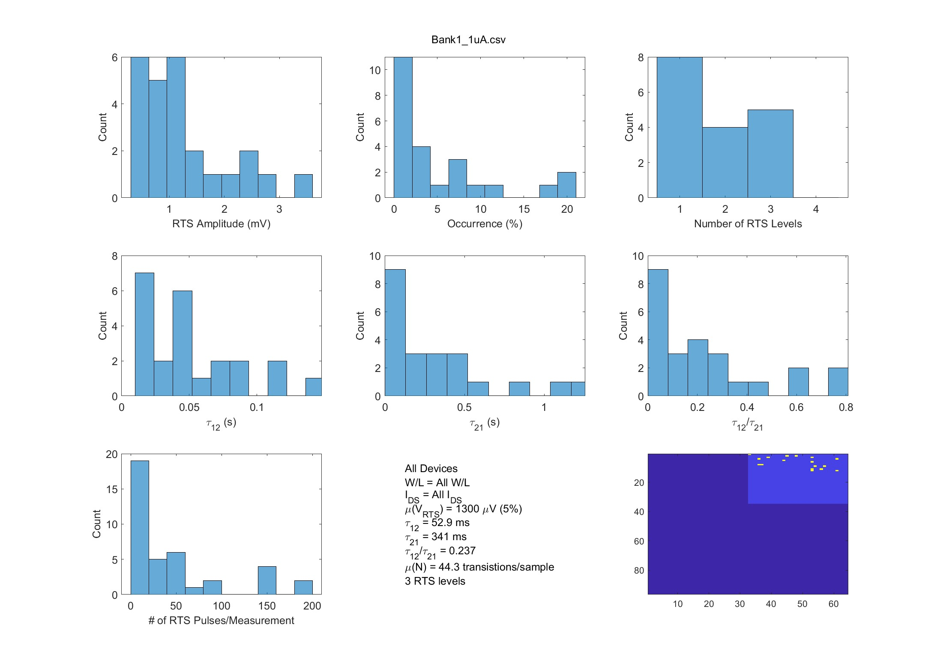
Bank 1 I_{bias} = 1uA Aggregate Data

Slide 15
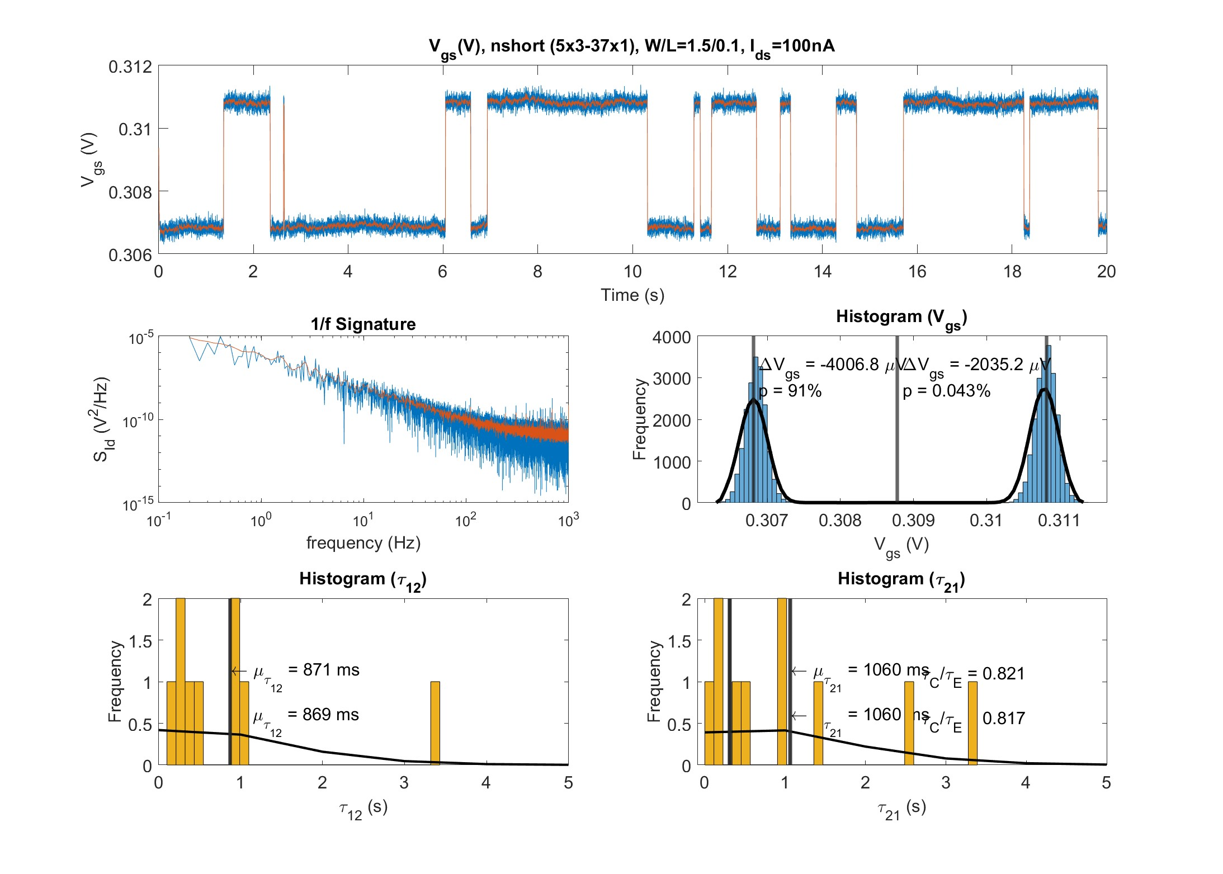
Bank 1 I_{bias} = 100nA Extracted Data

Slide 16
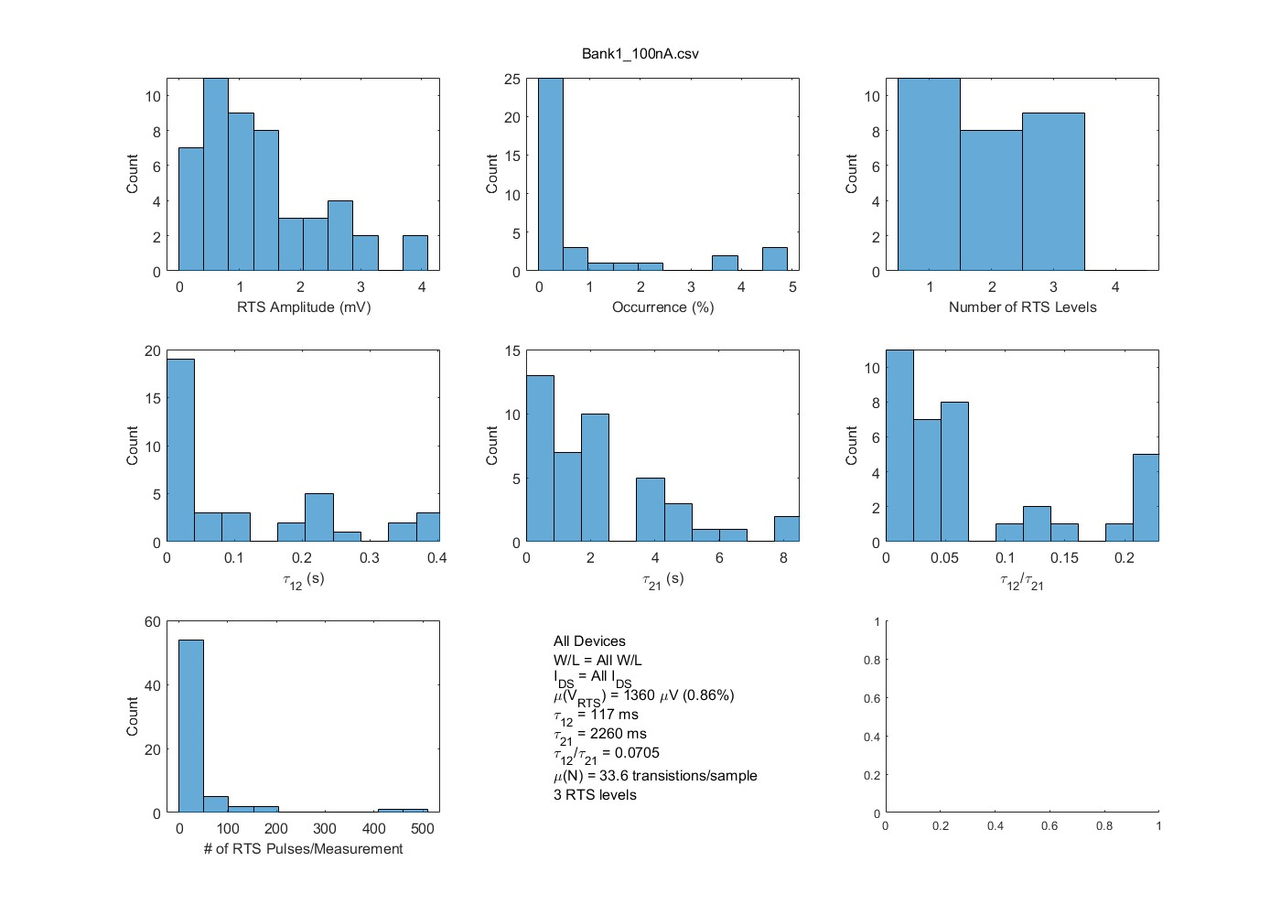
Bank 1 I_{bias} = 100nA Aggregate Data

Slide 17
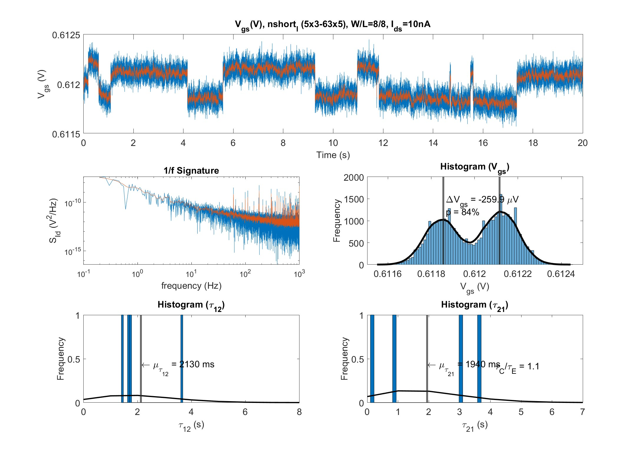
Bank 1 I_{bias} = 10nA Extracted Data

Slide 18
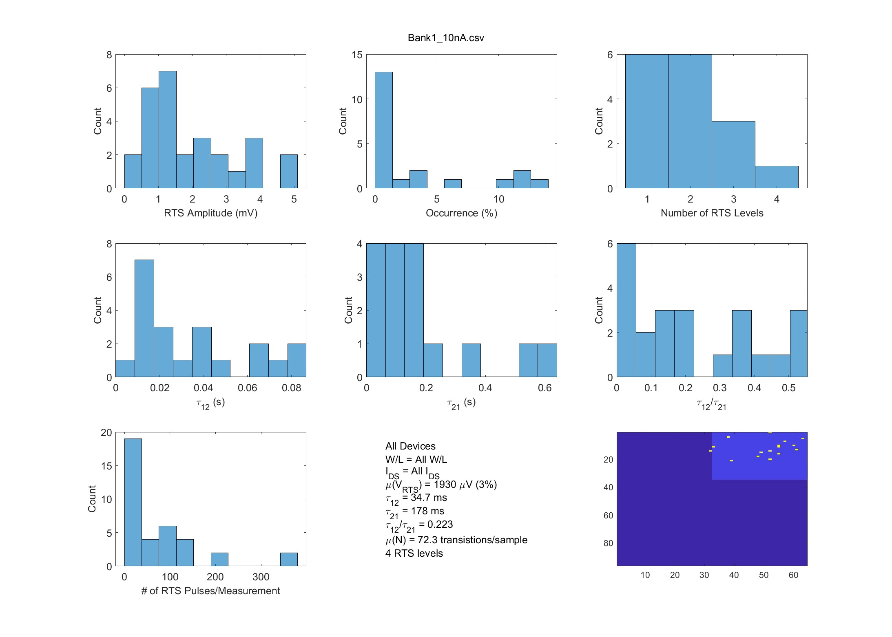
Bank 1 I_{bias} = 10nA Aggregate Data

Slide 19
Appendix

Slide 20
Bank 0 RTS Data Collection Progress
Bank | Type | W/L | Column | Bias Condition | Samples | Bias Condition | Samples | Bias Condition | Samples | Bias Condition | Samples
0 | nshort | 0.28/0.1 | 0,1 | 10 uA | 288 | 1uA | 248 | 100 nA | 192 | 10 nA | 192
0 | nshort | 0.28/8 | 2,3 | 10 uA | 192 | 1uA | 152 | 100 nA | 192 | 10 nA | 192
0 | nshort | 1.5/0.1 | 4,5 | 10 uA | 192 | 1uA | 152 | 100 nA | 192 | 10 nA | 192
0 | nshort | 1.5/0.35 | 6,7 | 10 uA | 192 | 1uA | 152 | 100 nA | 192 | 10 nA | 192
0 | nshort | 1.5/1.6 | 8,9 | 10 uA | 192 | 1uA | 152 | 100 nA | 192 | 10 nA | 192
0 | nshort | 1.5/8 | 10,11 | 10 uA | 192 | 1uA | 152 | 100 nA | 192 | 10 nA | 192
0 | nshort | 8/0.1 | 12,13 | 10 uA | 192 | 1uA | 152 | 100 nA | 192 | 10 nA | 192
0 | nshort | 8/8 | 14,15 | 10 uA | 192 | 1uA | 152 | 100 nA | 192 | 10 nA | 192
0 | nshort_l | 0.28/0.1 | 16,17 | 10 uA | 192 | 1uA | 152 | 100 nA | 192 | 10 nA | 192
0 | nshort_l | 0.28/8 | 18,19 | 10 uA | 192 | 1uA | 152 | 100 nA | 192 | 10 nA | 192
0 | nshort_l | 1.5/0.1 | 20,21 | 10 uA | 192 | 1uA | 152 | 100 nA | 192 | 10 nA | 192
0 | nshort_l | 1.5/0.35 | 22,23 | 10 uA | 192 | 1uA | 152 | 100 nA | 192 | 10 nA | 192
0 | nshort_l | 1.5/1.6 | 24,25 | 10 uA | 192 | 1uA | 152 | 100 nA | 192 | 10 nA | 192
0 | nshort_l | 1.5/8 | 26,27 | 10 uA | 192 | 1uA | 152 | 100 nA | 192 | 10 nA | 192
0 | nshort_l | 8/0.1 | 28,29 | 10 uA | 192 | 1uA | 152 | 100 nA | 192 | 10 nA | 192
0 | nshort_l | 8/8 | 30,31 | 10 uA | 192 | 1uA | 152 | 100 nA | 192 | 10 nA | 192

Slide 21
Bank 1 RTS Data Collection Progress
Bank | Type | W/L | Column | Bias Condition | Samples | Bias Condition | Samples | Bias Condition | Samples | Bias Condition | Samples
1 | nshort | 0.28/0.1 | 32,33 | 10 uA | 302 | 1uA | 26 | 100 nA | 34 | 10 nA | 282
1 | nshort | 0.28/8 | 34,35 | 10 uA | 302 | 1uA | 26 | 100 nA | 34 | 10 nA | 202
1 | nshort | 1.5/0.1 | 36,37 | 10 uA | 301 | 1uA | 26 | 100 nA | 34 | 10 nA | 202
1 | nshort | 1.5/0.35 | 38,39 | 10 uA | 300 | 1uA | 26 | 100 nA | 34 | 10 nA | 202
1 | nshort | 1.5/1.6 | 40,41 | 10 uA | 300 | 1uA | 26 | 100 nA | 34 | 10 nA | 202
1 | nshort | 1.5/8 | 42,43 | 10 uA | 300 | 1uA | 26 | 100 nA | 34 | 10 nA | 202
1 | nshort | 8/0.1 | 44,45 | 10 uA | 300 | 1uA | 26 | 100 nA | 34 | 10 nA | 202
1 | nshort | 8/8 | 46,47 | 10 uA | 300 | 1uA | 26 | 100 nA | 34 | 10 nA | 202
1 | nshort_l | 0.28/0.1 | 48,49 | 10 uA | 300 | 1uA | 26 | 100 nA | 34 | 10 nA | 202
1 | nshort_l | 0.28/8 | 50,51 | 10 uA | 300 | 1uA | 26 | 100 nA | 34 | 10 nA | 202
1 | nshort_l | 1.5/0.1 | 52,53 | 10 uA | 300 | 1uA | 26 | 100 nA | 34 | 10 nA | 202
1 | nshort_l | 1.5/0.35 | 54,55 | 10 uA | 300 | 1uA | 26 | 100 nA | 34 | 10 nA | 202
1 | nshort_l | 1.5/1.6 | 56,57 | 10 uA | 300 | 1uA | 26 | 100 nA | 34 | 10 nA | 202
1 | nshort_l | 1.5/8 | 58,59 | 10 uA | 300 | 1uA | 26 | 100 nA | 34 | 10 nA | 202
1 | nshort_l | 8/0.1 | 60,61 | 10 uA | 300 | 1uA | 26 | 100 nA | 34 | 10 nA | 202
1 | nshort_l | 8/8 | 62,63 | 10 uA | 300 | 1uA | 26 | 100 nA | 34 | 10 nA | 202

Slide 22
Bank 2 RTS Data Collection Progress
Bank | Type | W/L | Column | Bias Condition | Samples | Bias Condition | Samples | Bias Condition | Samples | Bias Condition | Samples
2 | nthickbc | 0.42/0.35 | 64,65 | 10 uA | 192 | 1uA | 296 | 100 nA | 0 | 10 nA | 0
2 | nthickbc | 0.42/8 | 66,67 | 10 uA | 192 | 1uA | 296 | 100 nA | 0 | 10 nA | 0
2 | nthickbc | 1.2/0.35 | 68,69 | 10 uA | 192 | 1uA | 296 | 100 nA | 0 | 10 nA | 0
2 | nthickbc | 1.2/0.5 | 70,71 | 10 uA | 192 | 1uA | 296 | 100 nA | 0 | 10 nA | 0
2 | nthickbc | 1.2/0.8 | 72,73 | 10 uA | 192 | 1uA | 296 | 100 nA | 0 | 10 nA | 0
2 | nthickbc | 1.2/8 | 74,75 | 10 uA | 192 | 1uA | 296 | 100 nA | 0 | 10 nA | 0
2 | nthickbc | 8/0.35 | 76,77 | 10 uA | 192 | 1uA | 296 | 100 nA | 0 | 10 nA | 0
2 | nthick | 8/8 | 78,79 | 10 uA | 192 | 1uA | 296 | 100 nA | 0 | 10 nA | 0
2 | nthick | 0.42/0.35 | 80,81 | 10 uA | 192 | 1uA | 296 | 100 nA | 0 | 10 nA | 0
2 | nthick | 0.42/8 | 82,83 | 10 uA | 192 | 1uA | 296 | 100 nA | 0 | 10 nA | 0
2 | nthick | 1.2/0.35 | 84,85 | 10 uA | 192 | 1uA | 296 | 100 nA | 0 | 10 nA | 0
2 | nthick | 1.2/0.5 | 86,87 | 10 uA | 192 | 1uA | 296 | 100 nA | 0 | 10 nA | 0
2 | nthick | 1.2/0.8 | 88,89 | 10 uA | 192 | 1uA | 296 | 100 nA | 0 | 10 nA | 0
2 | nthick | 1.2/8 | 90,91 | 10 uA | 192 | 1uA | 296 | 100 nA | 0 | 10 nA | 0
2 | nthick | 8/8 | 92,93 | 10 uA | 192 | 1uA | 296 | 100 nA | 0 | 10 nA | 0
2 | nthickbc | 8/8 | 94,95 | 10 uA | 192 | 1uA | 296 | 100 nA | 0 | 10 nA | 0

